Slide 1


Investigate the impact of Twitter on local non-profits around the KW region
Social Media
Datathon
Kick off: Saturday 16th Oct: 9am - 11am
Presentations: Saturday 23rd Oct: 9am - 12pm
Virtual

Slide 2
#datathon Agenda
Overview of Data for Good - Waterloo
What to expect at a Datathon
Business problem
Overview of the data

Slide 3
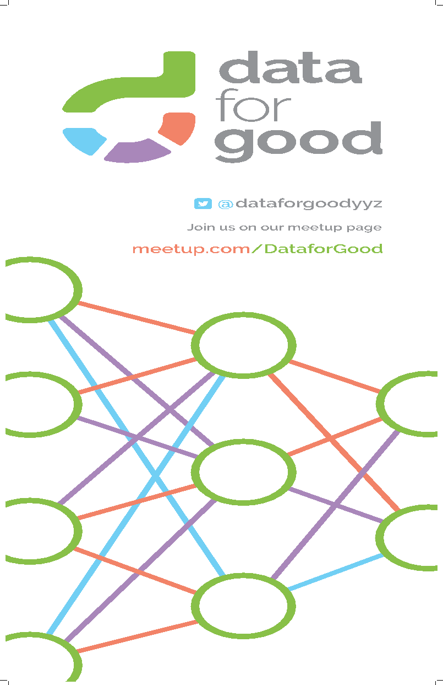
What is dataforgood?

Slide 4
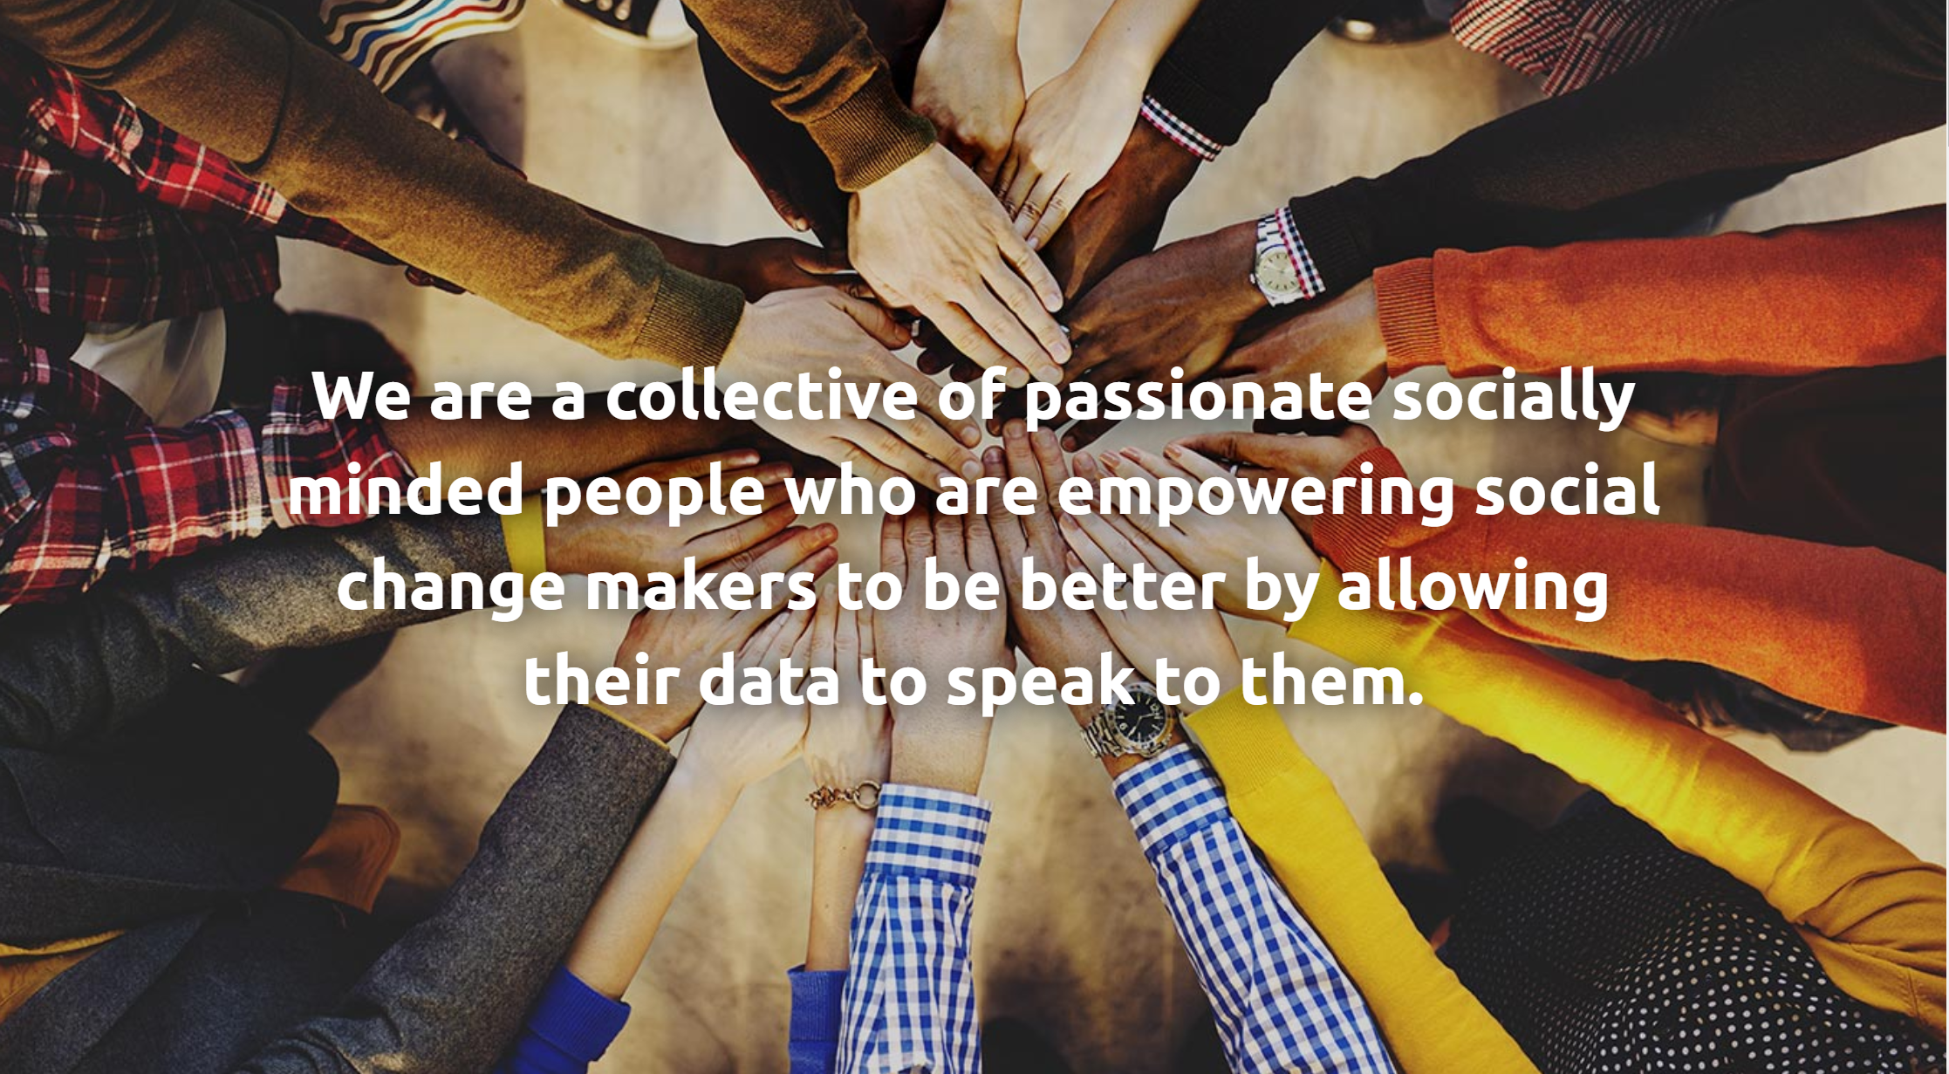
Notes:
Volunteer-driven organization aimed at creating positive social change through data science
Official launch Nov 2018
1000’s of volunteers nationwide with 800+ local members wo
We help non-profit organizations harness the power of their data to make more informed and better decisions. These organizations are often registered charities and funded by donations, so they do not have the funding for large (if any) data & analytics teams.
We work with these organizations to scope their business problems, explore their data, and then host datathons to solve the analytics problems.

Slide 5
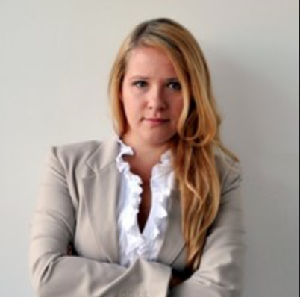
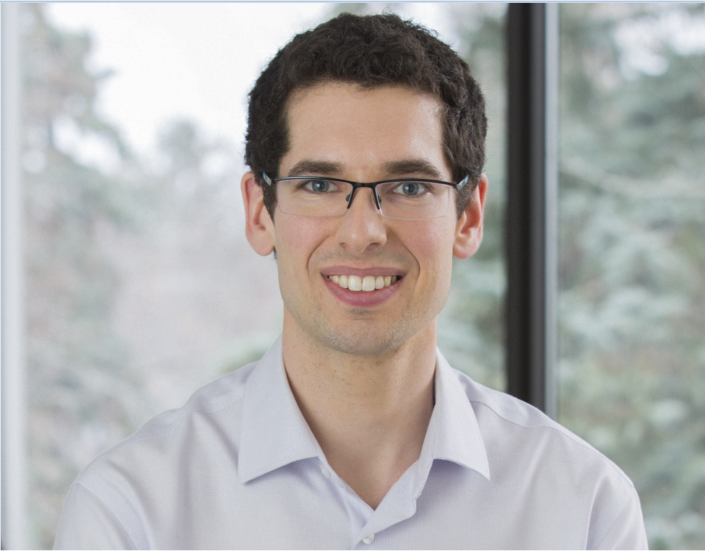
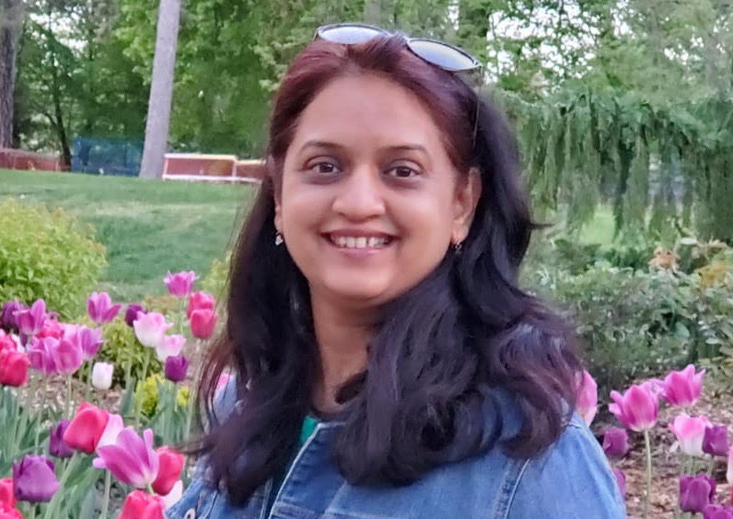
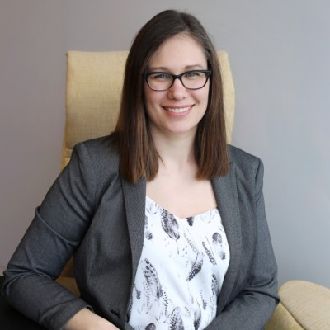
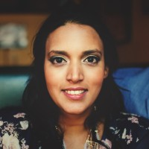
The Waterloo Region Team
Nadia Novikova
Client Acquisition & Partnership Lead
Jeffrey Baer
Leadership Team Advisor
Minita Dabhi
Social Media Coordinator
Melissa Kristensen
Operations Lead
Sasha Fay
Communications
Lead
Notes:
Nadia - work with non-profits to find projects that we can pursue and with data ambassadors to get their problem & data ready for a datathon
Sasha - responsible for managing and communicating with our "army of data scientists" and ensures they have all the information they need leading into a datathon
Jeffrey -
Minita -
Melissa - responsible for the logistics behind events and datathons

Slide 6
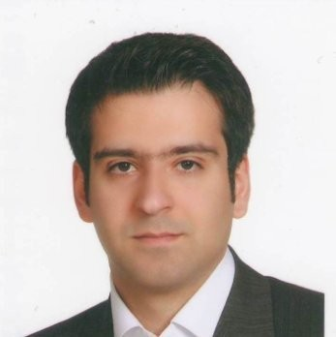
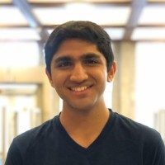
Data Ambassadors
Sepehr Sepehri
Data Engineer at Gensquared
https://www.linkedin.com/in/sepehr-sepehri/
Khush Bhavsar
Undergraduate Research Assistant at Institute for Quantum Computing
https://www.linkedin.com/in/khush-bhavsar/

Slide 7


Don’t forget to follow us!
@dataforgoodwr
www.linkedin.com/company/data-for-good-waterloo-region/

Slide 8
Introduction to
#datathon

Slide 9
#datathon context
Survey/Twitter Data Tutorial
#datathon
Datathon Prep
Follow Up
Notes:
Normally the first step is relationship building with a specific organization, but this time we did two things, had a tutorial for our members on scrapping and analyzing twitter data and we sent out a survey to non-profits in the region to see if they would be interested in this analysis. Guess what! They are!
Datathon prep - there has been a lot of work in the background to prepare for this Datathon! Our Data Ambassadors Khush and Sepehr (whom you will meet shortly) have worked hard to scrap the data and prepare the data that we will be using for analysis.
After the Datathon, we will be consolidating and fact-checking the main insights unearthed from today’s Datathon, so that we can package this information into meaningful take-aways for the organizations. We will be looking for volunteers

Slide 10
#datathon timeline
#datathon kick-off
Outline business problem, review the data, and answer questions
#datathon presentations
Present your findings and compete to win!
THIS WEEK
AFTER THE DATATHON
TODAY
NEXT SATURDAY
Analyze data & check-in
Work with your team to analyze the data, solve the business problem, and create a presentation
Check-in meeting with a DFG representative
Report Writing
Volunteer to help pull all the insights together into one report

Slide 11
#datathon during the week
We have set-up a slack channel for the event here, feel free to post question throughout the week: https://dataforgoodkw.slack.com/twitter_datathon
If you are working in a team, it is up to you & your team members to set-up a method of communication (slack, email, google meet, etc.)
We will set-up a midweek check-in for your team. The email to coordinate a time will be sent this weekend.
Code from the tutorial can be found HERE

Slide 12
#datathon presentations
Upload your presentation by 830am on Sat Oct 23
Time limit will be between 5-10 minutes (exact limit will be set this weekend and set to you)
If you are stuck we can provide a presentation template
Group presentation order will be picked randomly

Slide 13
#datathon judging
Category | Description | Rating
Impact | Did they articulate why their analysis will help non-profits? | 1 to 4, low to high
Data visualization | Did they provide clear and aesthetically pleasing visuals to help present their findings? | 1 to 4, low to high
Communication | Were they able to articulate the findings from their analysis? | 1 to 4, low to high
Innovation | Did they learn a new tool, language, or software or create an original tool? Were they innovated in their overall analysis? | 1 to 4, low to high
Vision | Do they have a clear vision of next steps: ways to bring these ideas to life or questions for further analysis? | 1 to 4, low to high
Time limit | Did they stay within the time limit? | Over by 2 min = -2 Over by 5 min+ = -4
Sum score from each category and
the HIGHEST SCORE WINS a certificate, a prize, and bragging rights

Slide 14

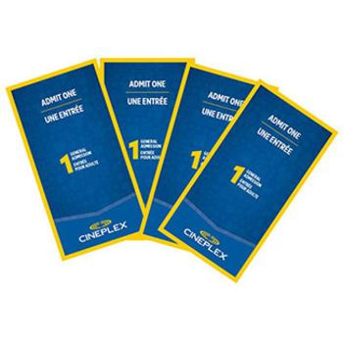
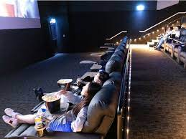
#datathon sponsor & prize

Slide 15
Questions?

Slide 16
Business Problem

Slide 17

Business Problem
How can we increase engagement?
Notes:
We sent out a survey to nonprofits in the region and 20 organizations are interested in this analysis
More than half currently do not track their social media data, which is why this datathon is so important
The top uses of social media from these organizations were to recruit volunteers, advertise events/programs, and for education purposes
Are there ‘best practice’ Twitter strategies that seem to be consistently successful?
What are the social media trends for nonprofits?
How effective are we at generating engagement?

Slide 18
Questions to get you started
What are the common themes for posts that drive engagement ?
Which posts have the maximum engagement? (likes, re-tweets, etc.)
Would a different engagement strategy be useful for different types of nonprofits? E.g. arts & culture vs. social services
Does a certain time of day/week/month generate more engagement?
Does a certain type of post generate more engagement? E.g. a poll/call to action/question/etc.? Or the type of media (words/picture/video/etc.)?
Are there keywords or hashtags that drive more engagement, like free/new/ donate/help/volunteer/etc. ?
Does the sentiment of the post have an impact on engagement?

Slide 19
Dataset
Overview

Slide 20
Data Overview
TWEET DATA
Data Structure & Scope
The list of organizations were provided by the Volunteer Action Centre in KW
Each row is a unique tweet and each column is a variable described below
This dataset has 184,743 records
Tweets from Jan 2010 - Jun 2021, 10,000 most recent tweets
Data Dictionary
tweet_id (int64): Unique ID for each tweet
user_id (int64): ID of the user, unique of each user
Created_at (str): UTC timestamp when the tweet was created
Screen_name (str): Screen name or alias that the user identifies with
Text (str): The actual UTF-8 text of the status update
Urls (str): string of a list of urls present in the tweet

Slide 21
Data Overview
TWEET DATA
Data Dictionary Continued
Favorite_count (int64): # of likes the tweet has
Retweet_count (int64): # of retweets the tweet has
URL (str): expanded urls in the tweets
Hashtags (str): list of hashtags in the tweet
Has_media (bool): True if tweet has media, false otherwise
is_quote (bool): True if the tweet is a quote tweet, false otherwise
Is_reply (bool): True if the tweet is a reply, false otherwise
Is_retweet : if the tweet is a retweet
Organization Name (str): Name of the organization
Text_clean: Text with most of the emojis, end whitespace, and punctuation removed

Slide 22
Data Overview
ORGANIZATION PROFILE
Data Structure
The list of organizations and categorization was provided by the Volunteer Action Centre
Each row is a unique non-profit organization and each column is described below
This dataset has 86 records
The organization can be linked to the Tweet dataset using the Screen_name
Data Dictionary
Organization_name (str): Name of the organization
Twitter_Handle (str): Twitter handle of organization
Screen_name (str): Twitter handle without ‘@’
Agency_category (str): Cause linked to the organization, e.g., Arts, Culture and Heritage, Disabilities, etc.
Followers_count (int64) : # of followers when Tweets were extracted
Friends_count (int64): # of friends when Tweets were extracted
Location (str): city, province of organization’s location

Slide 23
Known Data Limitations/Nuances
We were not able to extract comments on Tweets or mentions of the Tweets on other user’s accounts
We don’t have the account details for the followers/users that engaged
The time and date of the creation of a tweet is UTC, so it needs to be converted to EST/EDT for relevant analysis
Some re-tweet counts that are very high (e.g., 1 million+) because the tweet is actually a re-tweet from a very popular Twitter personality
The followers/friends count is the as of the data extraction date. Analysis cannot be performed to see the follower growth over time.

Slide 24
Questions?

Slide 25
Let’s Look at the Data!
Google drive link
You will receive a link to the data and this presentation by email shortly!

